Slide 1
Data Warehousing
Supervised vs. Unsupervised Learning

Slide 2
Data Structures in Data Mining
Data matrix
Table or database
n records and m attributes,
n >> m
C_{1,1}
C_{1,2}
C_{1,3}
…
C_{1,m}
C_{2,1}
C_{2,2}
C_{2,3}
C_{2,m}
C_{3,1}
C_{3,2}
C_{3,3}
C_{3,m}
.
.
.
.
.
.
…
C_{n,1}
C_{n,2}
C_{n,3}
C_{n,m}
1
S_{1,2}
S_{1,3}
…
S_{1,n}
Similarity matrix
Symmetric square matrix
n x n or m x m
S_{2,1}
1
S_{2,3}
S_{2,n}
S_{3,1}
S_{3,2}
1
S_{3,n}
.
.
.
.
.
.
…
S_{n,1}
S_{n,2}
S_{n,3}
1

Slide 3
Main types of DATA MINING
Supervised
Bayesian Modeling
Decision Trees
Neural Networks
Etc.
Unsupervised
One-way Clustering
Two-way Clustering
Type and number of classes are known in advance
Type and number of classes are NOT known in advance

Slide 4
Clustering: Min-Max Distance
Intra-cluster distances are minimized
outlier
Inter-cluster distances are maximized
Salary
20 40 60
Age

Slide 5
How Clustering works?

Slide 6
One-way clustering example
Black spots
are noise
White spots
are missing
data
INPUT
OUTPUT

Slide 7
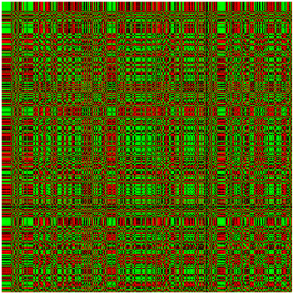

Data Mining Agriculture data
clusters
INPUT
Clustered OUTPUT

Slide 8
Classification
Which class?
Classifier (model)
Unseen Data

Slide 9
How Classification work?
Output
Inputs
Confidence
Level

Slide 10
Classification Process (1): Model Construction
Relationship between shopping time and items bought
Classification
Algorithms
Training
Data
(observations, measurements, etc.)
Classifier
(Model)
IF time/items >= 6
THEN gender = ‘F’

Slide 11
Classification Process (2): Use the Model in Prediction
Classifier
Testing
Data
Unseen Data
(Firdous, Time= 15 Items = 1)
Gender?
F

Slide 12
Clustering vs. Cluster Detection

Slide 13
Clustering vs. Cluster Detection Example
A
B

Slide 14
The K-Means Clustering

Slide 15
The K-Means Clustering: Example
A B
10
10
9
9
8
8
7
7
6
6
5
5
4
4
3
3
2
2
1
1
0
0
1
2
3
4
5
6
7
8
9
10
0
0
1
2
3
4
5
6
7
8
9
10
10
10
9
9
8
8
7
7
6
6
5
5
4
4
3
3
2
2
1
1
0
0
1
2
3
4
5
6
7
8
9
10
0
0
1
2
3
4
5
6
7
8
9
10
D C

Slide 16
The K-Means Clustering: Comment

